Slide 1
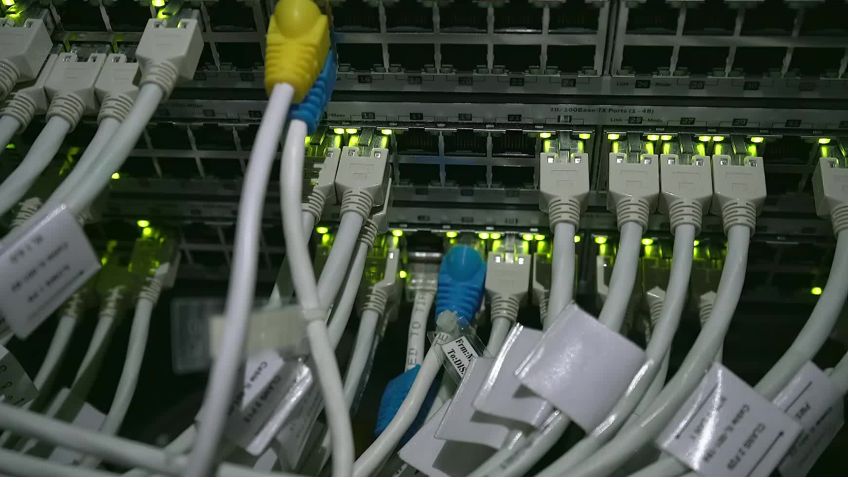
Implementing a Robust Network Design: Integrating Corporate LANs with WAN and Colocation Services for Emergency Resilience
Building resilient corporate networks for emergency preparedness
Notes:
AI-generated content may be incorrect. --- This presentation covers the comprehensive approach to designing a resilient corporate network by integrating Local Area Networks (LANs), Wide Area Networks (WANs), and colocation services. We will explore architecture, connectivity, emergency preparedness, implementation best practices, and future scalability. Image source: Microsoft 365 content library

Slide 2

Agenda Overview
Overview of Corporate Network Architecture
Designing and Connecting Multiple LANs as a WAN
Integration with Colocation Services for Emergency Outages
Implementation and Best Practices
Security, Compliance, and Future Scalability
Notes:
--- We will begin with an overview of corporate network architecture, followed by designing and connecting multiple LANs as a WAN. Next, we will discuss integration with colocation services for emergency resilience. Implementation best practices and security, compliance, and future scalability will conclude our discussion. Image source: Microsoft 365 content library

Slide 3
Overview of Corporate Network Architecture
Notes:
Understanding the fundamental building blocks of corporate LANs and their key requirements helps form the foundation of any robust network design. Security considerations are also critical to protect enterprise assets.

Slide 4

Fundamental Components of a LAN
Core LAN Devices
Switches and routers form the backbone of a LAN, enabling efficient data routing and communication.
Servers and Workstations
Servers provide resources and services, while workstations are user endpoints within the LAN.
Wireless Access Points
Wireless access points enable wireless connectivity and expand LAN coverage across the workspace.
Notes:
--- LANs typically include switches, routers, servers, workstations, and wireless access points. Proper design ensures efficient communication within the corporate environment and supports business operations. Image source: Microsoft 365 content library

Slide 5

Typical Enterprise Network Requirements
High Availability
Enterprise networks require high availability to ensure continuous business operations without interruptions.
Scalability
Networks must scale efficiently to support growing user bases and increased data traffic over time.
Performance and Bandwidth
High network performance and bandwidth support diverse applications and heavy user demand.
Integration and User Density
Networks must integrate with other systems and support high user density seamlessly.
Notes:
--- Requirements include high availability, scalability, performance, and support for diverse applications. Enterprises also need to address user density, bandwidth demands, and integration with other networks. Image source: Microsoft 365 content library

Slide 6

Security Considerations in LAN Design
Firewall Implementation
Firewalls act as a barrier to protect LANs from unauthorized external and internal access attempts.
VLAN Segmentation
VLAN segmentation isolates network segments to reduce attack surfaces and limit unauthorized access.
Access Control Lists
Access control lists define permissions controlling who can access specific network resources within the LAN.
Intrusion Detection Systems
Intrusion detection systems monitor network traffic to detect and respond to potential security breaches.
Notes:
--- Incorporating firewalls, VLAN segmentation, access control lists, and intrusion detection systems helps safeguard the LAN from internal and external threats, ensuring data integrity and confidentiality. Image source: Microsoft 365 content library

Slide 7
Designing and Connecting Multiple LANs as a WAN
Notes:
Connecting geographically dispersed LANs into a WAN involves selecting appropriate technologies, managing routing and redundancy, and optimizing traffic to maintain reliability and performance.

Slide 8
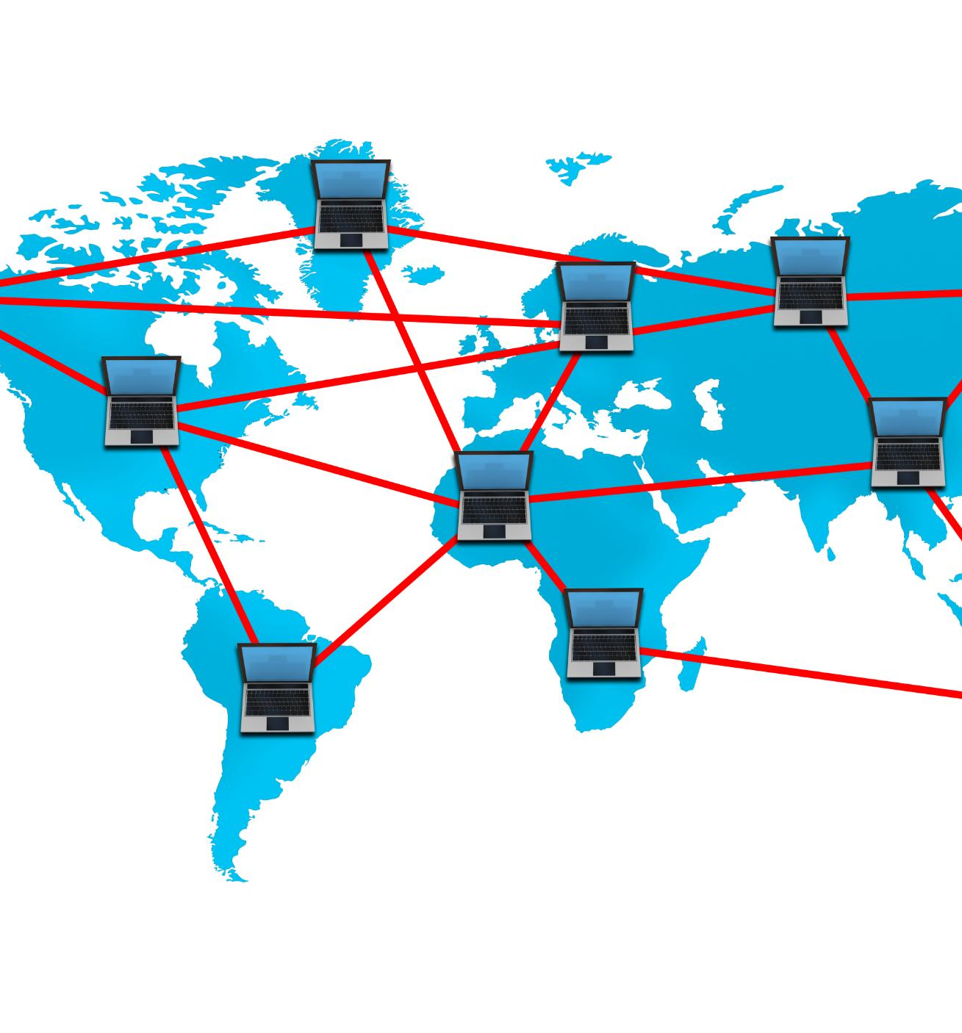
Interconnecting LANs Across Remote Sites
Methods of Interconnection
Link LANs using leased lines, MPLS, VPNs, or other WAN technologies for secure connectivity.
Site-to-Site Connectivity
Enables centralized resources and unified communication across an enterprise's remote locations.
Notes:
--- This involves linking LANs via leased lines, MPLS, VPNs, or other WAN links. Site-to-site connectivity supports centralized resources and unified communication across the enterprise. Image source: Microsoft 365 content library

Slide 9
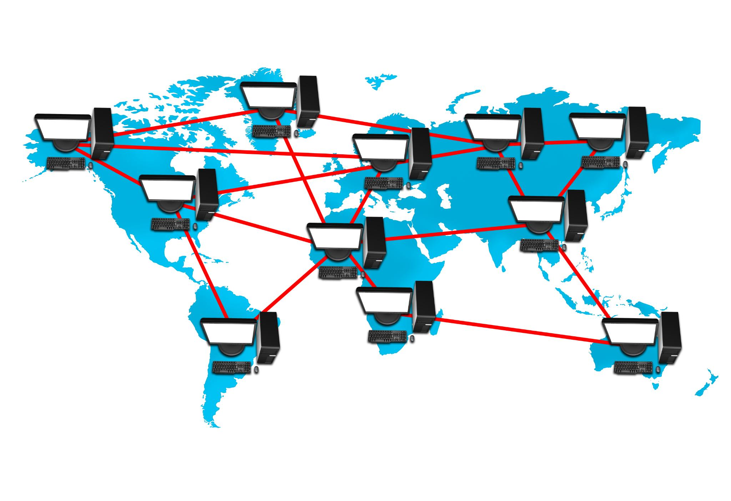
WAN Technologies and Protocols
MPLS Technology
MPLS provides efficient, scalable WAN connectivity by directing data through label-switched paths.
Metro Ethernet
Metro Ethernet offers high-speed, cost-effective WAN links connecting metropolitan area networks.
VPN Tunnels
VPN tunnels secure WAN communications over public networks using encryption and tunneling protocols.
Routing Protocols BGP and OSPF
BGP and OSPF protocols enable dynamic routing for scalable and flexible WAN interconnections.
Notes:
--- Common WAN technologies include MPLS, Metro Ethernet, and VPN tunnels using protocols such as BGP and OSPF, enabling scalable and flexible network interconnections. Image source: Microsoft 365 content library

Slide 10

Routing, Redundancy, and Traffic Management
Dynamic Routing
Dynamic routing protocols enable networks to adapt automatically to topology changes for optimized connectivity.
Redundant Links
Redundant links provide backup paths to enhance network reliability and prevent single points of failure.
Load Balancing
Load balancing distributes network traffic evenly across resources to optimize performance and prevent overload.
Quality of Service (QoS)
QoS prioritizes critical traffic to maintain performance for important applications and services.
Notes:
--- Implementing dynamic routing, redundant links, load balancing, and Quality of Service (QoS) ensures network resilience, optimal resource use, and prioritization of critical traffic. Image source: Microsoft 365 content library

Slide 11
Integration with Colocation Services for Emergency Outages
Notes:
Colocation facilities provide secure and reliable infrastructure for disaster recovery. Integrating these services into the network enhances business continuity during emergencies.

Slide 12

Purpose and Advantages of Colocation Services
Redundant Power and Cooling
Colocation facilities provide reliable redundant power and cooling systems to ensure continuous operation of critical equipment.
Enhanced Physical Security
Physical security measures in colocation centers protect hardware from unauthorized access and physical threats.
High-Speed Connectivity
Colocation services offer high-speed network connectivity, enabling fast and reliable data transmission for hosted systems.
Reduced Downtime Risks
By leveraging offsite hosting in colocation centers, organizations minimize downtime risks and improve system availability.
Notes:
--- Colocation offers redundant power, cooling, and physical security, along with high-speed connectivity, enabling organizations to host critical systems offsite with minimal downtime risk. Image source: Microsoft 365 content library

Slide 13

Network Failover and Disaster Recovery Strategies
Automated Failover Mechanisms
Automated failover mechanisms switch traffic seamlessly to backup systems during network outages.
Backup Systems at Colocation Sites
Backup systems located at colocation sites provide redundancy to ensure continuous service availability.
Rapid Disaster Recovery
Effective strategies enable rapid recovery with minimal impact after outages or disasters.
Notes:
--- Designing automated failover mechanisms and maintaining backup systems at colocation sites ensures rapid recovery and minimal impact during outages or disasters. Image source: Microsoft 365 content library

Slide 14
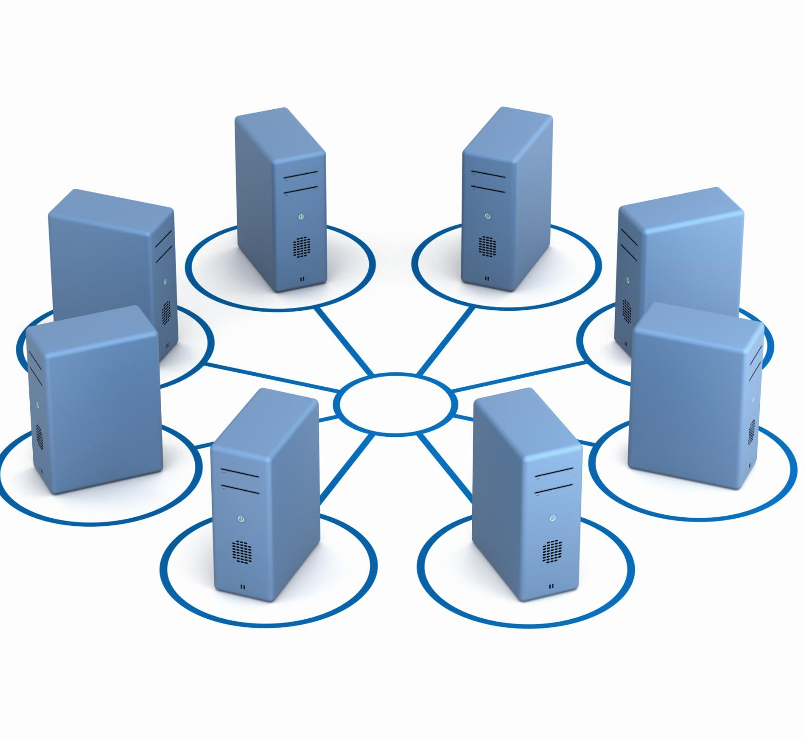
Configuration of Backup Links to Colo Sites
Importance of Backup Links
Backup links provide redundancy to prevent downtime by maintaining connectivity if primary links fail.
Types of Backup Connections
Secondary WAN connections and VPN tunnels serve as reliable alternatives for primary network paths.
Ensuring Continuous Connectivity
Redundant backup configurations ensure seamless network operation to colocation facilities under failures.
Notes:
--- Establishing diverse and redundant backup links, such as secondary WAN connections or VPN tunnels, ensures continuous connectivity to colocation facilities when primary links fail. Image source: Microsoft 365 content library

Slide 15
Implementation and Best Practices
Notes:
A structured deployment approach, ongoing monitoring, and rigorous testing are essential for successful network implementation and ensuring readiness for outage scenarios.

Slide 16

Step-by-Step Deployment Process
Planning Phase
The planning phase involves defining requirements and designing the network infrastructure for deployment.
Hardware Procurement
Hardware procurement includes acquiring necessary devices and equipment essential for network setup.
Configuration and Integration
Configuration and integration involve setting up devices and connecting components for seamless operation.
Validation Phase
Validation includes testing and verifying network functionality to ensure proper deployment.
Notes:
--- This includes planning, hardware procurement, configuration, integration, and validation phases to systematically build and deploy the network infrastructure. Image source: Microsoft 365 content library

Slide 17

Monitoring and Managing Network Health
Continuous Monitoring
Ongoing network monitoring allows early detection of issues before they impact users.
Performance Optimization
Network tools help optimize system performance for reliability and speed.
SLA Compliance
Monitoring ensures service level agreements are met to maintain quality standards.
Notes:
--- Continuous monitoring using network management tools helps detect issues early, optimize performance, and maintain SLA compliance. Image source: Microsoft 365 content library

Slide 18

Testing and Validation of Outage Response
Failover Drills Importance
Regular failover drills prepare teams and systems for seamless transition during network outages.
Disaster Recovery Validation
Validating disaster recovery plans ensures readiness and minimizes downtime during real emergencies.
Notes:
--- Regularly conducting failover drills and validating disaster recovery plans ensures the network and teams are prepared for real emergencies. Image source: Microsoft 365 content library

Slide 19
Security, Compliance, and Future Scalability
Notes:
Maintaining security, adhering to industry standards, and planning for growth are key to sustaining a robust and compliant corporate network.

Slide 20

Ensuring Security Across LAN, WAN, and Colo Connections
End-to-End Encryption
Encrypting data from source to destination ensures confidentiality and protects communications across networks.
Multi-Factor Authentication
Using multiple authentication factors strengthens access control to network resources and reduces unauthorized access.
Continuous Vulnerability Assessment
Regularly scanning and assessing network vulnerabilities helps identify and mitigate security risks promptly.
Notes:
--- Implementing end-to-end encryption, multi-factor authentication, and continuous vulnerability assessments protects all network segments from threats. Image source: Microsoft 365 content library

Slide 21

Compliance with Industry Standards
Legal Compliance Importance
Following industry standards ensures organizations meet legal requirements and avoid penalties.
Building Client Trust
Adhering to standards builds credibility and trust with clients and stakeholders.
Key Industry Standards
Standards like ISO, NIST, HIPAA, and GDPR guide organizations in compliance and data protection.
Notes:
--- Adhering to standards such as ISO, NIST, HIPAA, or GDPR ensures legal compliance and builds trust with clients and stakeholders. Image source: Microsoft 365 content library

Slide 22

Planning for Network Expansion and Future Technologies
Scalable Network Architecture
Designing networks to easily scale ensures adaptability to increasing data and device demands.
SD-WAN Technology
Incorporating SD-WAN improves network efficiency and flexibility across distributed locations.
IoT Integration
Supporting IoT devices enables smarter data collection and real-time monitoring capabilities.
Cloud Integration
Integrating cloud services allows for flexible resource management and enhanced collaboration.
Notes:
--- Designing scalable architectures that support emerging technologies like SD-WAN, IoT, and cloud integration prepares the network for future demands. Image source: Microsoft 365 content library

Slide 23
Conclusion
Integrated Network Design
Combining LANs, WANs, and colocation services creates a robust and resilient enterprise network.
Security and Performance
Best practices in network design enhance security and ensure optimal performance across the system.
Preparedness and Growth
Well-designed networks prepare enterprises for emergencies and support future growth and scalability.
Notes:
Robust network design integrating LANs, WANs, and colocation services is vital for enterprise resilience. Following best practices ensures security, performance, and preparedness for emergencies while supporting future growth.

